Slide 1

Maintenance and use of ctu DB-Under reamer
By :
Mahdi Sheikh Zare
Summer 2018

Slide 2
work content
Overview
preparation
Tool maintenance process
End of maintenance

Slide 3
preparation
2-4 prepare the assembly drawing

Slide 4
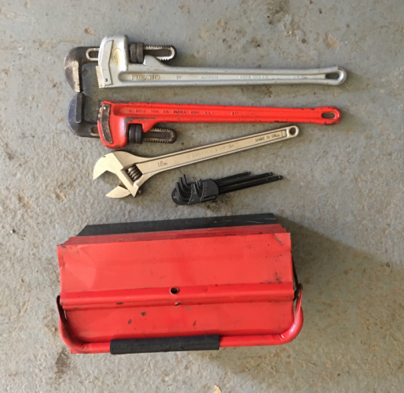
preparation
2-5 Required auxiliary equipment and related Hand tools:

Slide 5
preparation
DB-Under reamer Parts lists

Slide 6
Tool maintenance process
Thru-Tubing DB-Under reamer Tool maintenance special tools and commonly used hand tools
No | Tool Name | Quantity | Note
1 | Vise | 1
2 | 24”Pipe wrenches | 2
3 | Adjustable wrench | 1
4 | Allen wrench | Some
5 | Common Hand Tools | some
6 | O ring special tools | 1

Slide 7
Tool maintenance process
2-5 Safety related requirements
2-5-1 the maintenance place is an indoor maintenance place. Try to avoid the maintenance of windy weather.
2-5-2 Safety identification inspections include, but are not limited to: (1) wearing PPE; (2) avoiding mechanical injuries and the like.

Slide 8
Tool maintenance process
3-1 Removal steps
3-1-1 Hold the upper body of the tool on the vise
Upper body
Drive sleeve[6]
Lower body [13]

Slide 9
Tool maintenance process
3-1 Removal steps
3-1-2 Remove all set screws
Note: End face head captive screws each cap screw has two captive screws that need to be removed completely.

Slide 10
Tool maintenance process
3-1 Removal steps
3-1-3 Remove the face cutter [28 ]

Slide 11
Tool maintenance process
3-1 Removal steps
3-1-4 Loosen the lower body until the blade pin holes align with the pin holes on the lower body.

Slide 12
Tool maintenance process
3-1 Removal steps
3-1-5 Remove a total of three cutter blades with remove blade pin [24]

Slide 13
Tool maintenance process
3-1 Removal steps
3-1-6 Remove the lower body [13]

Slide 14
Tool maintenance process
3-1 Removal steps
3-1-7 Remove the Top sub [1] set screw [2].

Slide 15
Tool maintenance process
3-1 Removal steps
3-1-8 Remove the Top sub [1]and spring [5]from drive sleeve[6].

Slide 16
Tool maintenance process
3-1 Removal steps
3-1-9 Remove the small drive pin [19A (3ea)] that connects the nozzle holder and the mandrel [4]

Slide 17
Tool maintenance process
3-1 Removal steps
3-1-9 Remove nozzle carrier [14]

Slide 18
Tool maintenance process
3-1 Removal steps
3-1-11 Remove the drive pin [6]

Slide 19
Tool maintenance process
3-1 Removal steps
3-1-11 remove the large drive pins [9(3ea)]

Slide 20
Tool maintenance process
3-1 Removal steps
3-1-11 Remove the mandrel [4]

Slide 21
Tool maintenance process
3-1 Removal steps
3-1-12 Place the components neatly

Slide 22
3-2 Check list and maintenance
No | Check item | Quantity | Note
1 | O-Ring | 14ea
2 | spring | 1ea
3 | Steel ball | 1ea
4 | Pin | 12ea
a. If any of the above accessories is damaged, replace the new one directly
b. Use clean cotton yarn to clean the tool ensure all accessories are clean

Slide 23
3-3 installation steps
3-3-1 Fix the upper body on the vise.

Slide 24
3-3 installation steps
3-3-2 put the mandrel into the upper body

Slide 25
3-1 Removal steps
3-3-2 Grease the large drive pin and install the large drive pin along the groove in the spindle

Slide 26
3-3 Removal steps
3-3-3 push the mandrel into the upper body, note that the pin should be stuck in the pin groove of the upper body, and put the rotary mandrel into place after pushing it into position

Slide 27
3-1
3-4 Mounting drive sleeve [6]

Slide 28
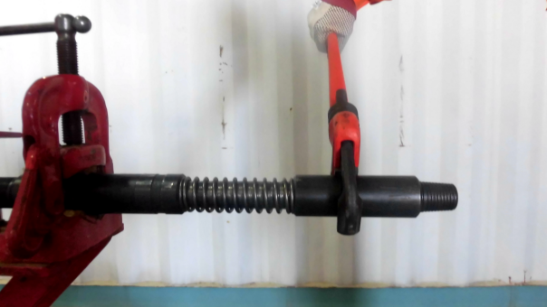
3-1 Removal steps
3-3-5 Install the top sub [1]
Top sub [1]

Slide 29
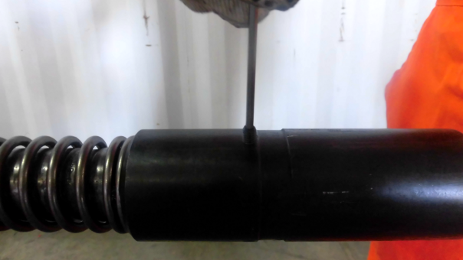
3-1 Removal steps
3-3-5 Install the top sub[1] fastening set screw[2]
Fastening Set screw [2]

Slide 30
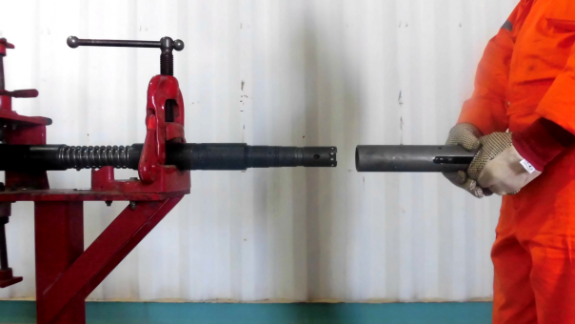
3-1 Removal steps
3-3-5 Connect the lower body[13] onto the nozzle seat and the upper body[10].
Upper body[10] [2]
Nozzle carrier [14]
Lower body[13]

Slide 31
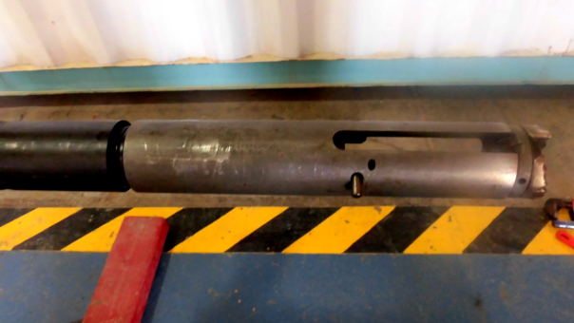
3-1 Removal steps
3-3-6 The rotary buckle is aligned with the pin hole of the lower body[13] and the pin hole of the nozzle seat, and can be passed through the pin once to ensure that the pin holes are aligned;
Some threads will not tighten
Pins pass once to ensure pin hole alignment

Slide 32
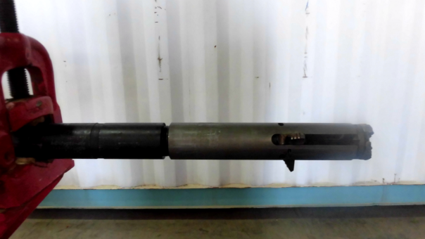
3-1 Removal steps
3-3-6 Install three cutter blades, rotate the lower shell after each blade installation to ensure that the position of the blade fastening pins is correct;
Three blades are installed. After each blade is installed, rotate the lower shell to determine whether the pin position is good or not.

Slide 33
عکس کامل توولز بعد از بستن

Slide 34
Tool maintenance process
3.1 Inspect all O-rings on each component for damage.
3.2 After using diesel oil to remove oil from the components of the tool, clean it with clean water and blow it with compressed air, especially to ensure that the inner wall of the tool barrel is clean.
3.3 Check all parts for damage.
3.4 Replace the damaged part and record the part number of the newly replaced part on the maintenance log sheet.
3.5 Apply a little oil on the surface of each spring and O-ring

Slide 35
4- End of maintenance
4-1 Tool disposal
4-1-1 Apply a small amount of butter to all the exposed threads and holes in the tool
4-1-2 Wear wire on both ends of the tool
4-1-3 pressure test the tools
4-2 fill in the document
4-2-1 remove the pressure record card and fill in relevant information (country area, oilfield name, well name, tool name, date, time, etc.)
4-2-2 Fill in the tool maintenance record form, CTU engineers must sign and confirm
4-2-3 Fill in the tool status label and attach it to the wire

Slide 36
End Of Maintenance
Apply a small amount of butter to all the exposed threads and holes in the tool. Wear wire on both ends of the tool; Move the test pressure qualified tool to the qualified equipment area. Remove the pressure record card and fill in the relevant information (country, region, field name, well name, tool name, date, time, etc.). Fill in the tool maintenance record form, and the coiled tubing engineer must sign and confirm it. Fill in the tool status label and attach it to the wire. Neatly tidy tools, remove safety signs and warning tapes, report forms and drawings, provide convenience for next operation, and clean wastes, such as old seals, on the spot according to waste disposal regulations.

Slide 37
5- Finishing work
Neatly tidy up the tools, remove safety signs and warning tapes, and archive reports and drawings to facilitate the next operation. Clean wastes and other waste seals in accordance with waste disposal regulations.

Slide 38
Thanks for your attention

